Slide 1


Leveraging Artificial Intelligence for Business Transformation
Welcome to the future of business, where Artificial Intelligence is revolutionizing industries and transforming the way we work. This presentation will explore the key aspects of AI literacy, its impact on organizations and individuals, and the strategies to embrace this transformative technology.
by Akshay Damodar

Slide 2
Understanding AI Literacy: A Fundamental Shift in the Workplace
What is AI Literacy?
Why it Matters
AI literacy encompasses understanding AI concepts, its capabilities, and its ethical implications. It involves critical thinking about AI's applications, limitations, and potential impacts.
AI literacy empowers individuals to leverage AI effectively, collaborate with AI systems, and navigate the evolving workplace landscape.

Slide 3

Bridging the AI Usage and Literacy Gaps Across the Enterprise
AI Usage Gap
AI Literacy Gap
Many businesses adopt AI solutions without a clear understanding of their capabilities and limitations.
Employees lack the knowledge and skills to effectively use and collaborate with AI, hindering its full potential.
The Solution
Bridging these gaps requires comprehensive training programs, accessible resources, and a culture of continuous learning.

Slide 4

Demystifying Large Language Models (LLMs): The Foundation of Generative AI
1
Understanding LLMs
2
Generative AI
LLMs are complex AI models trained on vast datasets of text and code, enabling them to generate human-like text, translate languages, and answer questions.
Generative AI, powered by LLMs, creates new content, designs, and solutions, transforming creative fields and business operations.
3
Applications
LLMs are revolutionizing industries like content creation, customer service, and data analysis, enabling businesses to automate tasks and create personalized experiences.

Slide 5





Compounding Effects of AI Literacy: Individual and Organizational Gains
Improved Decision-Making
1
Informed decisions based on data insights.
Enhanced Productivity
2
Automation of routine tasks, freeing up time for creative endeavors.
Increased Innovation
3
Exploration of new opportunities and creative solutions.
Competitive Advantage
4
Faster adaptation to changing market demands.
Sustainable Growth
5
Long-term success driven by AI-powered strategies.

Slide 6





Enabling an AI-Literate Workforce: Strategies for Leaders
Training and Development
Accessible Resources
Invest in comprehensive training programs to equip employees with the necessary AI skills.
Provide access to online courses, tutorials, and internal knowledge repositories.
Collaborative Environments
Continuous Feedback
Foster a culture of collaboration and knowledge sharing among employees.
Provide regular feedback and opportunities for skill development.

Slide 7





Overcoming Resistance to AI: Fostering a Culture of Adoption
Transparency
Clearly communicate the benefits and potential risks of AI.
Employee Empowerment
Involve employees in the AI implementation process and address their concerns.
Ethical Guidelines
Establish clear ethical guidelines for AI usage and data privacy.
Skill Development
Provide training opportunities to enhance employees' confidence in using AI.

Slide 8
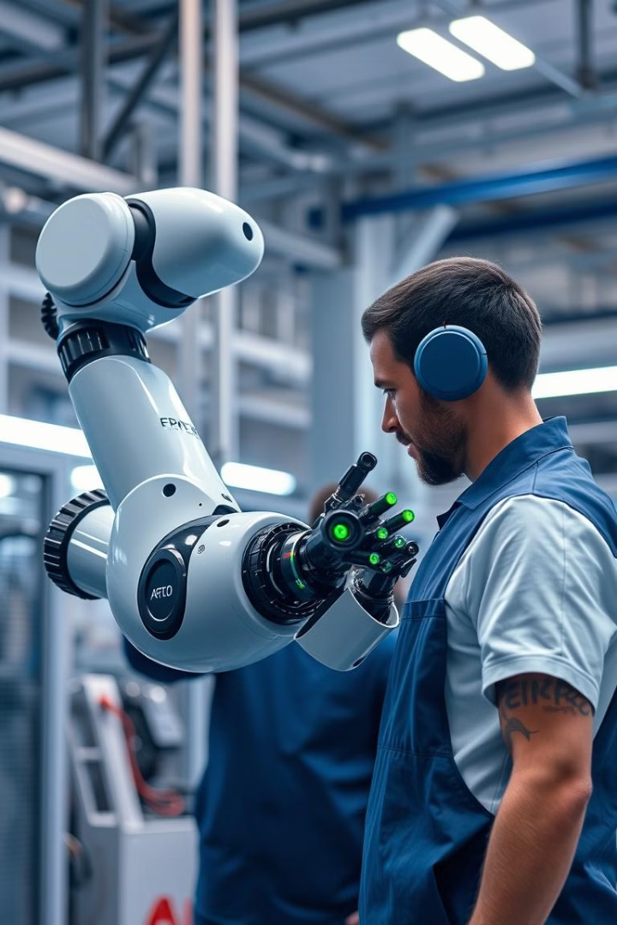
AI's Impact on Jobs: Augmentation vs. Automation
1
Job Augmentation
AI assists employees by automating routine tasks and providing insights, enhancing productivity and efficiency.
2
Job Automation
AI replaces repetitive and low-skilled tasks, leading to job displacement in some areas but creating opportunities in others.
3
Reskilling and Upskilling
Employees must adapt to the changing job market by acquiring new skills in AI-related fields.

Slide 9

AI as an Equalizer for Small Businesses
1
2
Level Playing Field
Enhanced Efficiency
AI empowers small businesses to compete with larger companies by providing access to advanced technologies.
AI automates tasks and optimizes operations, enabling small businesses to operate more effectively.
3
Personalized Experiences
AI allows small businesses to deliver tailored customer experiences, fostering stronger customer relationships.

Slide 10



Embracing the Future of AI-Powered Entrepreneurship
The future of entrepreneurship lies in embracing AI as a transformative tool. By fostering an AI-literate workforce and leveraging AI's capabilities, businesses can unlock new opportunities and create a more sustainable and equitable future.

